Slide 1
Towards a Masquerade Detection System Based on User’s Tasks
J. Benito Camiña, Jorge Rodríguez, and Raúl Monroy
Presentation by Calvin Raines

Slide 2
What is a masquerade attack?
Hello
<Your Name Here>
password123
Notes:
Masquerade attacker achieves “member” status by posing as legitimate user
Methods: Password cracked/stolen; terminal left open while away

Slide 3
How can masquerades be detected?
Audit data
Commands
I/O devices
Search patterns
File system navigation
User “Tasks”
Notes:
Anomaly based detection: Normal user profile is built, alarm raised if usage differs significantly from profile.

Slide 4
What were some previous approaches?
Intrusion detection expert system (IDES)
Earliest form of masquerade detection system (MDS)
Used audit data
Looked at sequences of actions
Shonalu et al. (Unix commands)
First general MDS test set
Logs of user commands broken into chunks
Jack
ls cd ls…
get open…
open close…
…
get get...
g++ vi vi…
get close…
Jill
cd vi…
vi g++…
./pgm vi…
…
ls vi close…
get open…
cd ls vi…
Normal
Attack
Notes:
IDES: Denning, D.E.: An intrusion-detection model. IEEE Transactions on Software Engineering
13(2), 222–232 (1987)
Schonlau, M.: Masquerading user data (Matthias Schonlau’s home page) (1998),
http://www.schonlau.net

Slide 5
What were some previous approaches?
Mouse
Angle/speed of movement
Click/drag
Keyboard
Static or Free text
RUU (Are You You?)
Search patterns; 22 features
File access, process creation, browsing, etc.
Notes:
Mouse: Pusara, M., Brodley, C.: User re-authentication via mouse movements. In: Proceedings
of the 2004 ACM Workshop on Visualization and Data Mining for Computer
Security, VizSEC/DMSEC 2004, pp. 1–8. ACM (October 2004)
Garg, A., Rahalkar, R., Upadhyaya, S., Kwiat, K.: Profiling users in GUI based
systems masquerade detection. In: 2006 IEEE Information Assurance Workshop,
pp. 48–54. IEEE Computer Society Press (June 2006)
Keyboard: Killourhy, K., Maxion, R.: Why did my detector do that?! - predicting keystrokedynamics
error rates. In: Jha, S., Sommer, R., Kreibich, C. (eds.) RAID 2010.
LNCS, vol. 6307, pp. 256–276. Springer, Heidelberg (2010)
RUU: Salem, M.B., Stolfo, S.J.: Modeling user search behavior for masquerade detection.
In: Sommer, R., Balzarotti, D., Maier, G. (eds.) RAID 2011. LNCS, vol. 6961, pp.
181–200. Springer, Heidelberg (2011)

Slide 6
What weaknesses do the old ways have?
Intrusive recording
Static keyboard recording discourages new passwords
Specificity of results
Unix commands specific to OS
One versus the others (OVTO)
No true attacks in test set
RUU simulated attacks, but these were not faithful
Data sets are static
Notes:
Most previous approaches are not intrusive
“ “ “ are specific, but conceptually adaptable

Slide 7
What new dataset is used?
Critical concept: objects, not actions
Which file system objects accessed and how used
Directory Graph
Navigation System
Access Graph
C
CV | 10
PDF | 8
Cat | 3
C | Desktop | Misc | Work | CV
Music
Docs
Desktop
C | Desktop | PDF.pdf
C | Documents | Funny | Cat.gif
Work
School
Temp
Notes:
Access graph – recently accessed files/tasks with frequency and path info
Directory – Subtree containing “hot” files/tasks

Slide 8
What is WUIL?
Windows Users and Intruder simulations Logs dataset
20 Windows users normal activity
MS Windows audit tool
3 levels of attacks carried out on each user computer
Data theft attacks
Limited to 5 minute window
Carried out by same person
Notes:
Issues: Current results specific to windows
No other types of masquerade attacks considered
One (same person) versus the others (non attackers)

Slide 9
What attacks were simulated?
Basic – Opportunity
Searches My Documents for interesting looking names, opens the file, sends to self via email, and closes file
Intermediate – Prepared
Brings USB to copy files to, uses MS Windows’ search tool to find files with specific strings (e.g. *password*.*), remove USB and remove tracks
Advanced – Plotted
Uses .bat file to automatically copy files the intermediate attack found

Slide 10
What is task abstraction?
Assumption: Files in the same folder are related to each other, and thus using any file in a certain folder can be viewed as working on a task.
Directory
Supertask
Subdirectory A
Task 1
Object 1
Object 2
Object 3
Object 4
Task 2
Subdirectory B
Object 5
Object 6
Task 3
Object 7
Notes:
Assumption may not be true: one participant used multiple physical drives; another was disorganized

Slide 11
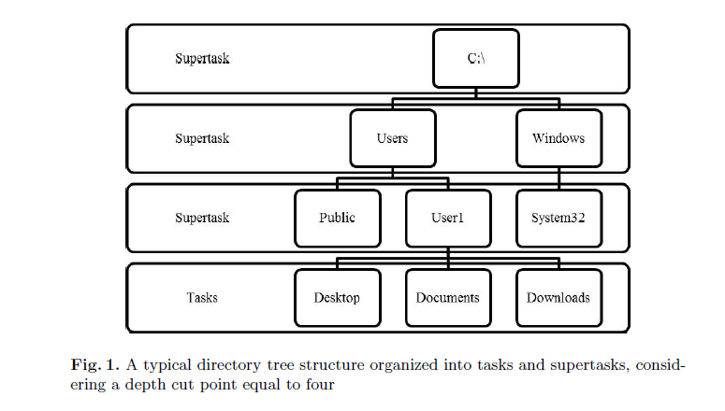
What is task abstraction?
Depth Cut Point
Deepest level for which >70% of task rate is underneath it
< 100 Tasks
3 < DCP < 10
Notes:
101 tasks is excessive
DCP4 is where desktop/documents/etc. are located
DCP10 is deep (assumed further depth unrealistic)

Slide 12
What are the benefits of task abstraction?
Less required storage
Resilient to change
Files added and deleted frequently

Slide 13
What experiments were performed?
Testing for:
Objects v. Tasks
How much information needed to detect attacks?
Different percentages of construction/validation
Approach:
Window based approach (unmixed, size 20)
Naïve Bayes and Markov Chains
Five-fold cross validation on best const/valid ratio
Notes:
Having unmixed windows ignores the possibility of a masquerader attacking in the middle of user activity (e.g. if user steps away and leaves terminal open)

Slide 14
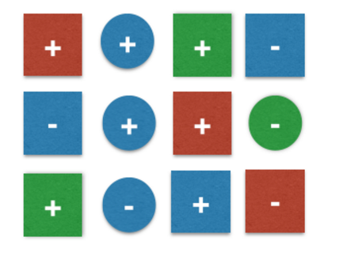
What is Naïve Bayes?
Frequency probability
?
Subset | + | -
squares | 5/8 | 3/8
blue | 3/6 | 3/6
all | 7/12 | 5/12
http://sebastianraschka.com/Articles/2014_naive_bayes_1.html

Slide 15
How was Naïve Bayes implemented?
Calculated
Symbol | Explanation
f_{uc} | number of times user (u) acceced resource (c)
a | 0 < a << 1 to prevent 0 probabilities
K | Total number of resources
n_{u} | Length of u’s training set
c_{i} | specific resource
Combined
Window size n = 20
Notes:
Dividing by n+aK – need to account both for number of files and length of training set

Slide 16
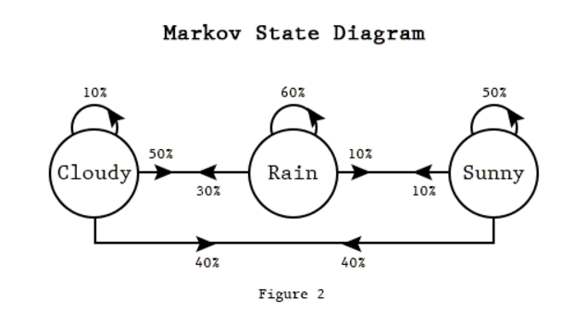
What are Markov Chains?
Sequence probability
Sequence | Probabilities | Total
SSSCRRRCS | .5x.5x.4x.5x.6x.6x.3x.4 | 0.00216
SRSRCCCSR | .1x.1x.1x.3x.1x.1x.4x.1 | 0.00000012
http://techeffigytutorials.blogspot.com/2015/01/markov-chains-explained.html

Slide 17
How were Markov Chains implemented?
Consider each day as an independent trace
Attack and normal traces separated
Determine n-gram size using divergence
Divergence – largest difference between normal and attack
Treat each n-gram within a trace as a state
Sum up 1-Probability of each state transition, divide by number of events
Penalty: if state transition nonexistent, add 5
If higher than threshold classify as an attack

Slide 18
How were Markov Chains implemented?
Day 1 | Fun | School | Fun | School | Fun | Fun
Day 2 | School | Fun | School | Fun | Fun | School
N-gram size 3
F
1
1
0.5
FS
FSF
0.66
1
FFS
-
0.33
1
SFF
0.5
1
1
S
SF
SFS

Slide 19
How were Markov Chains implemented?
Normal | School | Fun | School | Fun | School | Fun
Attack | School | School | School | Fun | Fun | Fun
(0.5+0+0+0+0.66+0)/6 | 0.19
(0.5+5+5+5+5+5)/6 | 4.25
Sum (1-Pr) / #events
Penalty: If Pr = 0, (1-Pr) = 5

Slide 20
How were results presented?
AUC
Notes:
Zero-FP: How many masquerades classified as normal
Zero-FN: How many normal misclassified as attacks

Slide 21
What were the Naïve Bayes results?
Notes:
80-20 is best split
Task better than object (Except on MMP FN)

Slide 22
What were the Markov Chains results?
Notes:
Same trends as Naïve Bayes
Better than naïve bayes

Slide 23
What is Mean-Windows-to-First-Alarm?
Average amount of windows needed to classify a trace as an attack
Notes:
Bayes faster at detecting stronger attacks (Partly due to unorganized participants)

Slide 24
What can be concluded?
Markov Chain model more accurate
Although, slower at detecting strong attacks
Task based detection comparable (slightly better) than object based detection

